Slide 1
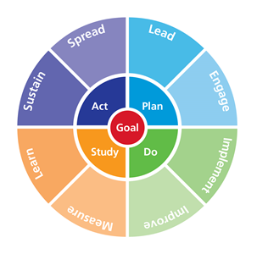
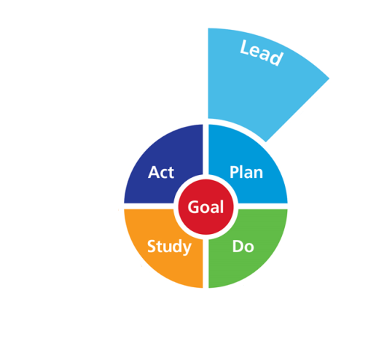
Bitesize Module:
The 5 Whys
CRN Continuous Improvement

Slide 2
Why is this happening?
Ever get the impression the same old problems keep returning?
You want to improve the outcome but are you sure you know what is truly causing it, therefore changing the right thing?
Taking the time to identify causes aims to stop this cycle.
Great leaders never jump to solutions and will take time to understand the root cause

Slide 3
5 Why analysis
A really simple tool to get to the bottom of problems.
Based on asking ‘Why?’ when faced with a problem. Usually it takes up to 5 ‘whys’.
Why?
Why?
Why?
Problem
Why?
Why?
Why?
Why?
Why?
Why?
Why?
Why?

Slide 4
Example
Got caught speeding
Why
SOLUTION:
Was late setting off from work
Why
Get an alarm that plugs into the mains or schedule changing the batteries at regular intervals
Got up late
Why
Alarm clock didn't work
Why
Batteries were flat
Why
Forgot to change the batteries

Slide 5
Research Example
The patient is being kept waiting
Why
SOLUTION:
To ask Principal Investigator to assist the RN in having a computer in the research clinic room or access via other means (e.g. tablet).
The Research Nurse has to return to their office
Why
The RN needs access to a computer to randomise
Why
They do not have access to a computer at hospital
Why
The research clinic room used does not have one in there
Why
No one has enquired as to whether this is possible

Slide 6
Optional Video Clips
https://www.youtube.com/watch?v=B-M3YlA2KDg&list=PLb1YdPkBtb0vECN0JgvipPu8NFAShh9-0&index=4 2.03 mins
https://www.youtube.com/watch?v=z3ZrpY85N4s&list=PLb1YdPkBtb0vECN0JgvipPu8NFAShh9-0&index=8 (funny but ?appropriate) 0.32 mins
https://www.youtube.com/watch?v=PSGf_vVKoI8&list=PLb1YdPkBtb0vECN0JgvipPu8NFAShh9-0&index=14 (funny but quality not great) 2.45 mins

Slide 7
Exercise
In pairs:
Work through the ‘5 Whys’ on a problem area of your own to establish why it happened, and share with the other person:
5 minutes on your own then 5 minutes to share
Keep asking why!!!
Swap so each of you get a go at applying this

